Slide 1
Cucumber Selenide allure
Together form a test framework
By Jari “Jarru” Heikkilä 2018
Jari.henrik.heikkila@gmail.com

Slide 2
Agenda
Introduction part
Demo part
Explanation part

Slide 3

Introduction part

Slide 4
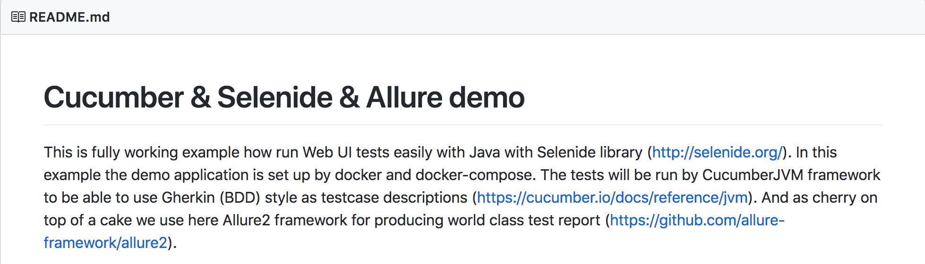
About this project it is my freetime project
https://github.com/jaheikki/cucumber-selenide-allure

Slide 5
Why this project
Still reasonably new stuff for me as well, just trying to learn more.
I use these tools in my projects, so I would like to keep my knowledge “stored in disk”, to get help when new work project starts.
As a bonus I can share my knowledge to my colleagues, having similar challenges in their projects.

Slide 6
Why this technology CucumbeR jvm, Java, maven, Selenide, Allure
Cucumber JVM is just layer on top of Java, the point is USE OF JAVA in acceptance tests. DEBUGGING Java in IDE is just MARVELLOUS and once you get used to that you won’t return back.
Cucumber is a way to achieve the Gherkin language (BDD style) and that enables making the test and documentation in same place (file). Otherwise use e.g. TestNG.
Maven is used for handling dependent Java libraries = pom.xml.
Selenide is a great way to make the the WEB UI test on top of Selenium.
Allure is just way to make ‘manager reports’ and support the idea of making code and documentation in same place together with Cucumber feature file. Notice that the ‘manager report’ is not needed for debugging the tests.

Slide 7
Goal for this demo
Goal is to give initial understanding of tools Cucumber JVM, Selenide and Allure2 and how they can be used together as a framework.
Goal is NOT to train you the details of tools used in this demo.
I hope you will learn by doing, in this case by cloning this demo project from github and get the demo running in your PC.
Next step is to make code changes locally in your PC and get the learning really started.

Slide 8
Tools used in demo
IntelliJIdea IDE
‘Cucumber for Java plugin’ in IntelliJIdea
Maven 3
Java 8
Cucumber JVM
Selenide
Several helper libraries, see pom.xml

Slide 9
Cucumber
The world's most misunderstood collaboration tool
Aslak HellesøyMar 3, 2014
https://cucumber.io/blog/2014/03/03/the-worlds-most-misunderstood-collaboration-tool
In 2003 I became part of a small clique of people from the XP community who were exploring better ways to do TDD. Dan North named this BDD. The idea was to combine automated acceptance tests, functional requirements and software documentation into one format that would be understandable by non-technical people as well as testing tools.

Slide 10
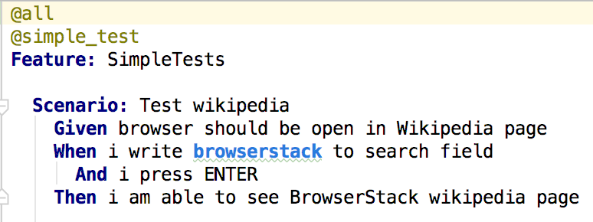
Cucumber example
Gherkin language (=BDD style) example:

Slide 11
Selenide
Selenide is a framework for WEB UI test automation powered by Selenium WebDriver that brings the following advantages:
Concise fluent API for tests
Ajax support for stable tests Powerful selectors
Simple configuration
http://selenide.org/quick-start.html
http://github.com/codeborne/selenide/wiki/Selenide-vs-Selenium

Slide 12
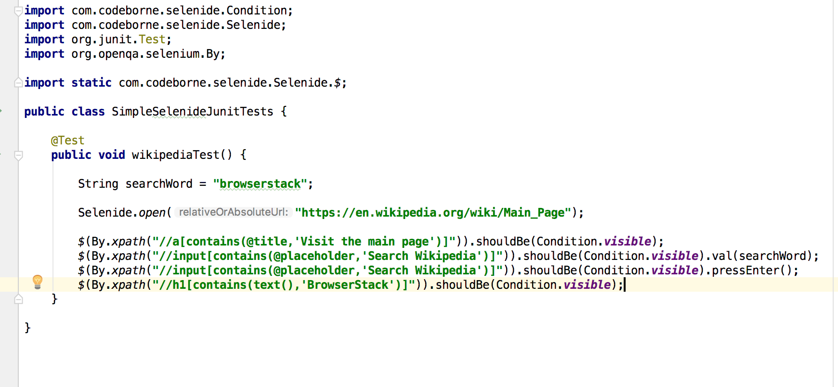
Selenide example

Slide 13
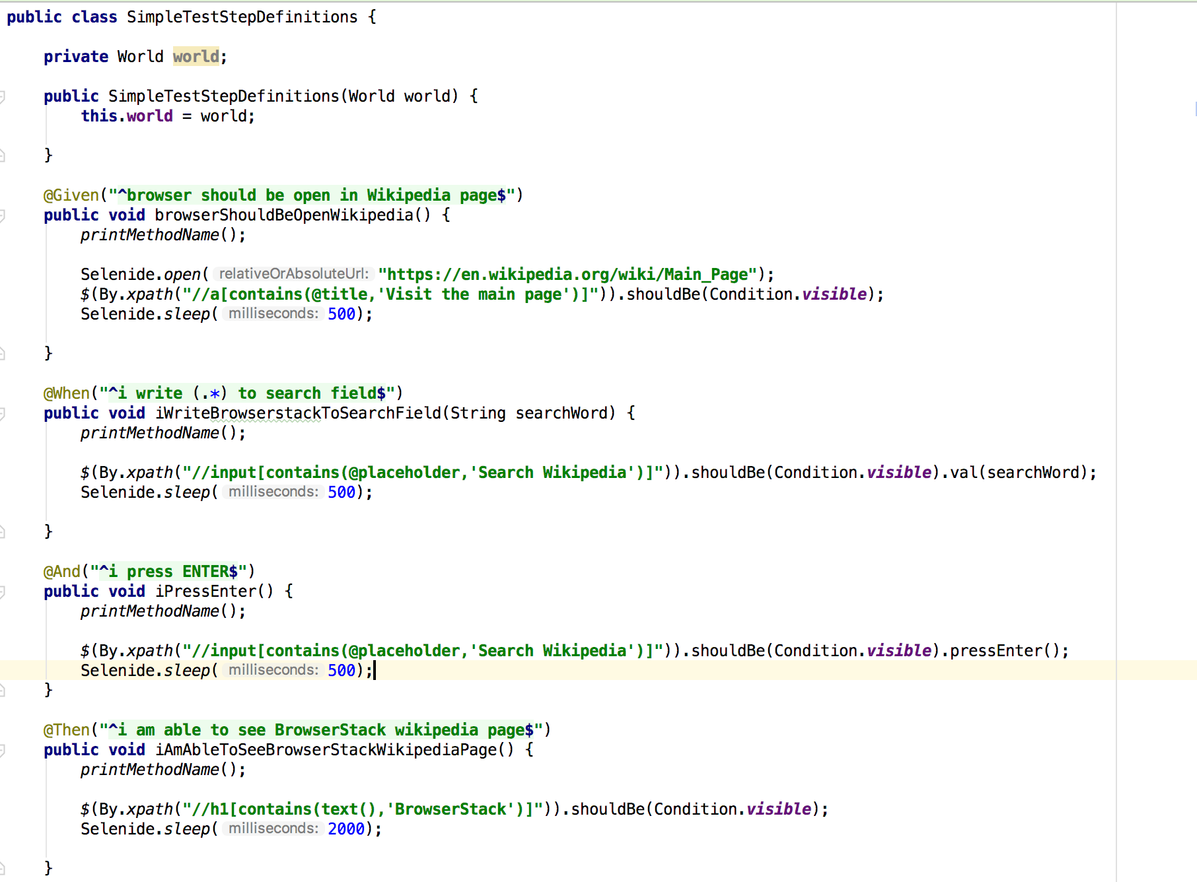
CUCUMBER JVM and selenide together

Slide 14
Allure
Allure Framework is a flexible lightweight multi-language test report tool
https://docs.qameta.io/allure/
https://github.com/allure-framework/allure-java/blob/master/allure-cucumber-jvm/src/test/resources/features/test.feature

Slide 15
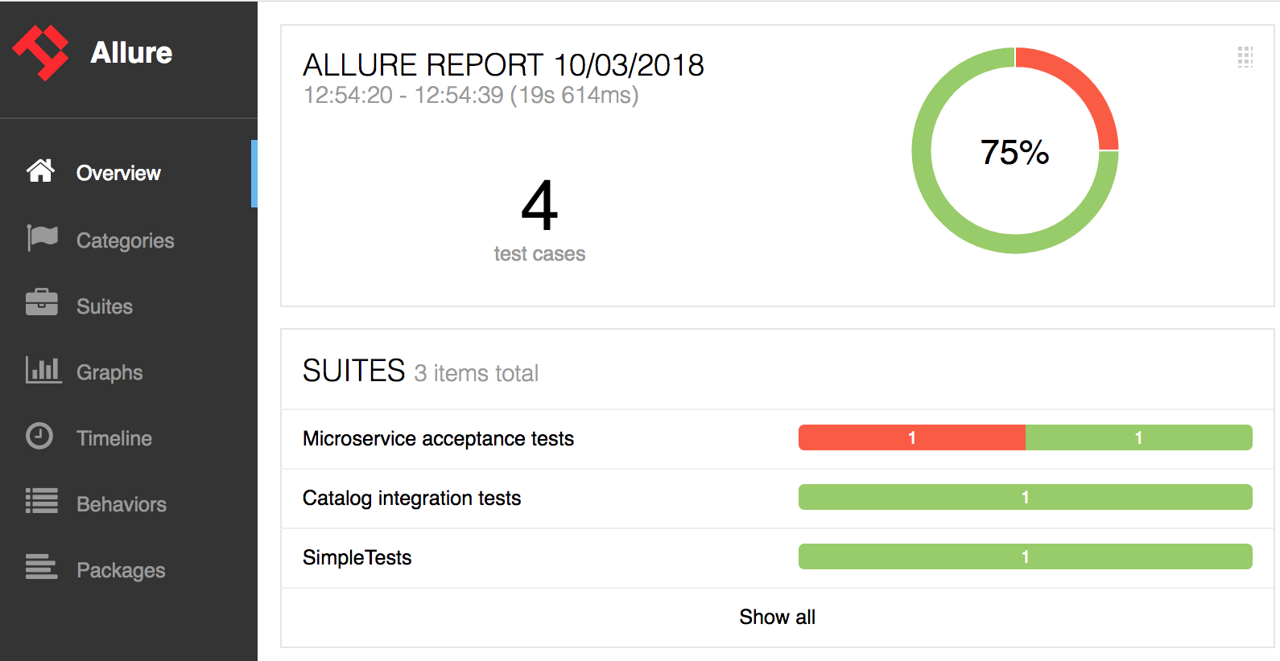
Allure report overview

Slide 16
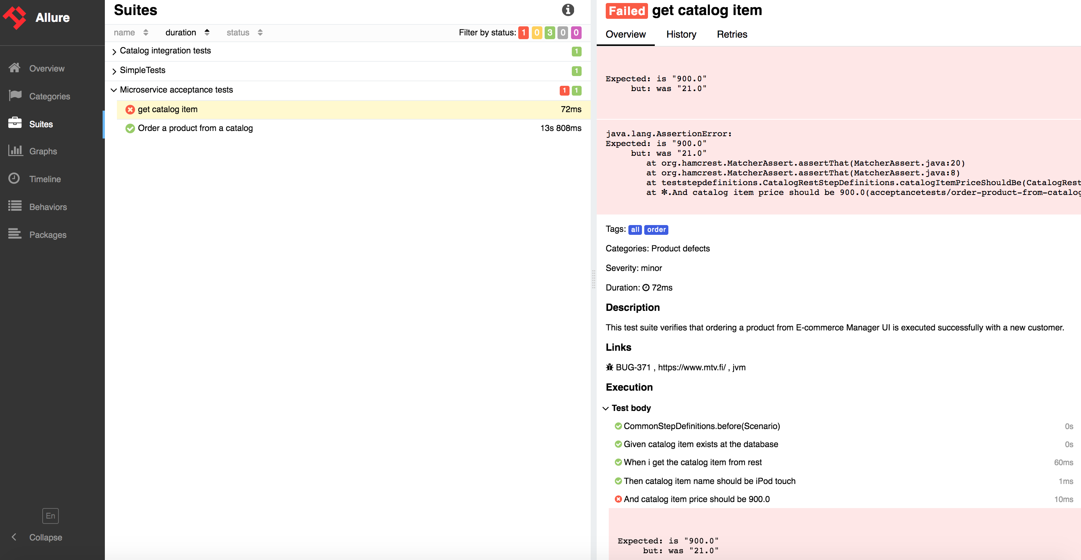
Allure report Test step report

Slide 17
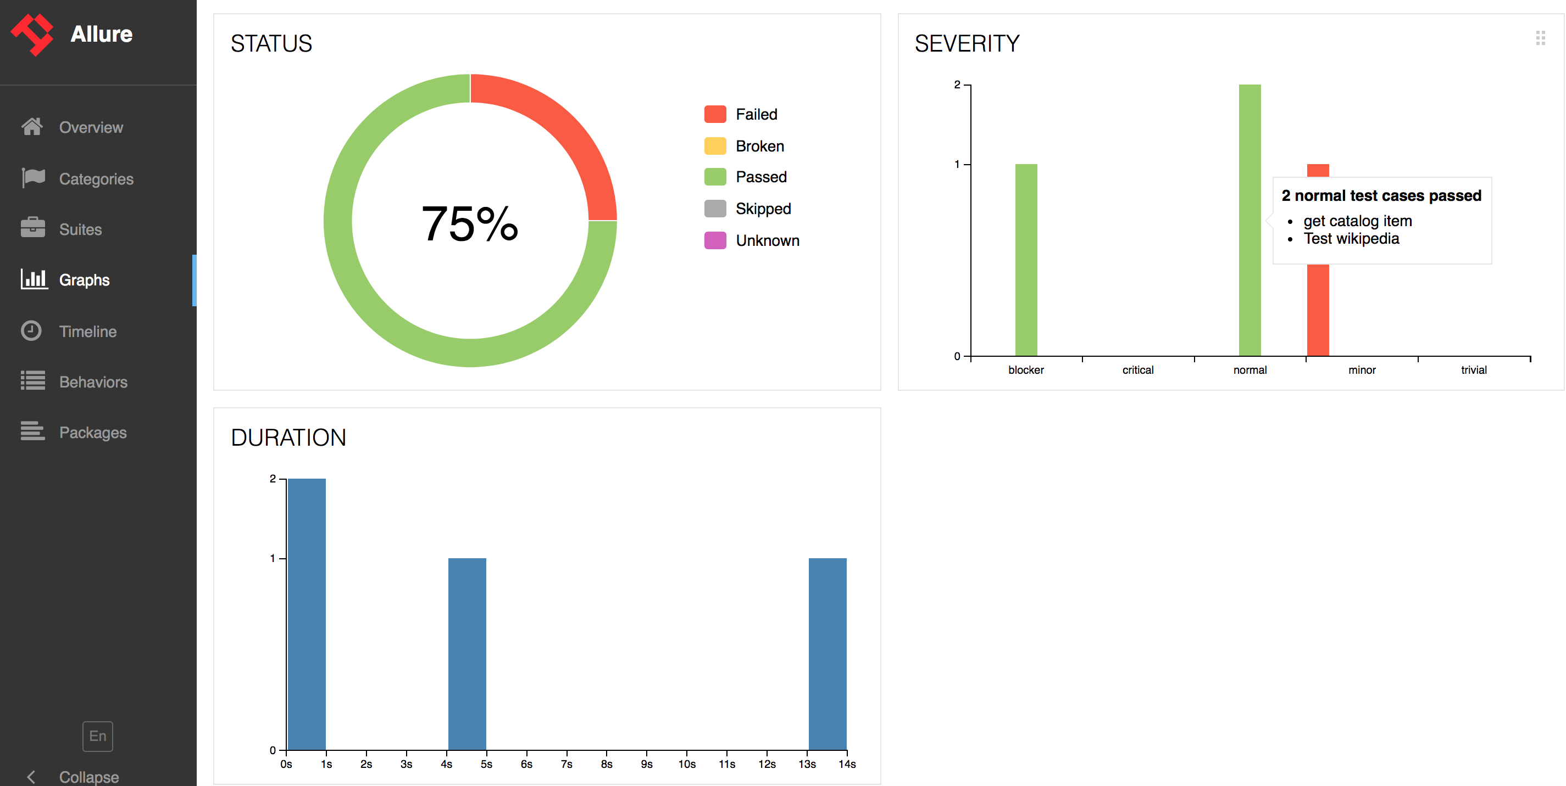
Allure report Graphs

Slide 18

THE DEMO PART
Based on running the script: cucumber-demo.sh
Note: Remember to source needed env variables (e.g. in this demo source ~/bs_creds.sh (personal credentials not published in github))
Note: Start VNC viewer before demo script

Slide 19

EXPLANATIOn part looking under the hood

Slide 20
Maven vs ide
Develop and run tests in IDE, in this case IntelliJ Idea.
In IDE you can:
Run all tests in all feature files from Cucumber jUnit runner class
Run single feature file (all scenarios inside single file)
Run single scenario (single test)
Add VM options e.g. ‘-Dbrowser=firefox’ in Run/Debug configuration in IntelliJ Idea.
Debug, use of breakpoints etc.
Maven is for:
Running tests in CI environment like Jenkins or GoCD
Getting Allure test report automatically.
Run specific amount of tests is based on Cucumber tags (e.g. --tags @simple_test).

Slide 21
RUN CUCUMBER with tag @order AND GENERATE REPORT
Mvn clean install -Dcucumber.options="--plugin io.qameta.allure.cucumberjvm.AllureCucumberJvm --tags @order”

Slide 22
Browser by selenide
-Dselenide.browser=firefox (or just -Dbrowser=firefox)
-Dselenide.browser-size=375x667
-Dremote=http://<hub host>/wd/hub

Slide 23
CUSTOM BROWSER And local grid
-Dselenide.browser=microservice.browser.FirefoxLinuxGridDriverProvider -Denv=local-grid
-Denv=local-grid means using local-grid.properties file as parameter source for tested service
Note: In this case the UI test is run inside docker container so the UI is not found from localhost
microservice_host=http://localhost:8080 vs
microservice_host=http://zuul:8080 #this is used

Slide 24
CUSTOM browser when running to browserstack
-Dbrowser=microservice.browser.SamsungGalaxyS7_V6_0_RemoteDriverProvider –Dlocal
-Dlocal = true means running tests in BrowserStack towards local UI
Note: -Denv not needed to define since local.properties is used by default

Slide 25
Cucumber JVM through Allure dependency
<dependency> <groupId>io.qameta.allure</groupId> <artifactId>allure-cucumber-jvm</artifactId> <version>2.0-BETA22</version> </dependency>
Yes, Allure 2.0 is still BETA but it works!
Note that allure-cucumber-jvm dependency brings both Allure 2 and Cucumber JVM dependencies
Note that Allure needs properly configured “maven-surefire-plugin” and “allure-mavem” plugin, see pom.xml

Slide 26
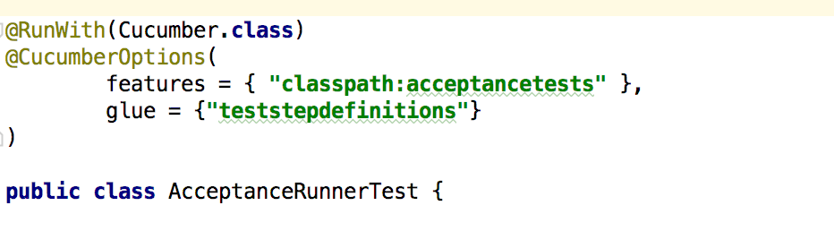
Cucumber jvm jUnit runner

Slide 27
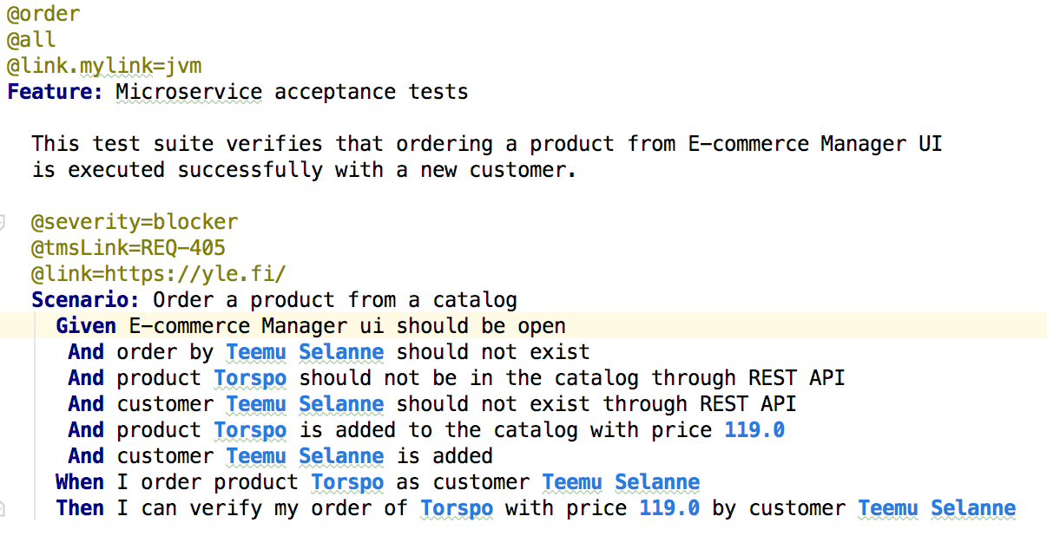
CUCUMBER JVM feature file

Slide 28
CUCUMBER JVM Test step definitions
In feature file:
And product Torspo is added to the catalog with price 119.0
In test step definitions file:
@And("product (.*) is added to the catalog with price (.*)") public void productIsAddedToTheCatalog(String catalogItem, String catalogItemPrice) { …;

Slide 29
Cucumber jvm multiple Test step defs
For very small project is enough to have just one step definition class file, but most likely you end up situation where steps are needed to be divided into several classes.
Do NOT do this: “Each feature file has a separate step definition file”
https://github.com/cucumber/cucumber/wiki/Feature-Coupled-Step-Definitions-(Antipattern)
Instead: https://github.com/cucumber/cucumber/wiki/Step-Organization

Slide 30
CUCUMBER JVM Sharing state between test step def files 1/3
Some dependency injection method needed, scary term?, no need to worry:
In this demo we use very simple Constructor Dependency Injection, CDI by using PicoContainer (see dependency from pom.xml).
http://www.thinkcode.se/blog/2017/04/01/sharing-state-between-steps-in-cucumberjvm-using-picocontainer
https://www.youtube.com/watch?v=upgTg_JiNbY

Slide 31
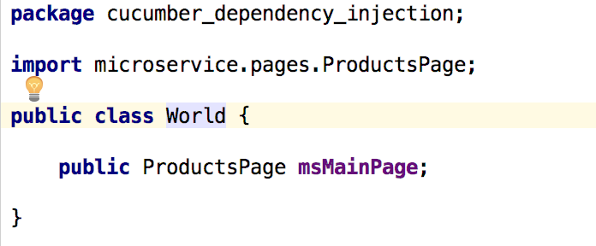
CUCUMBER JVM Sharing state between test step def files 2/3
Shared World object class:

Slide 32
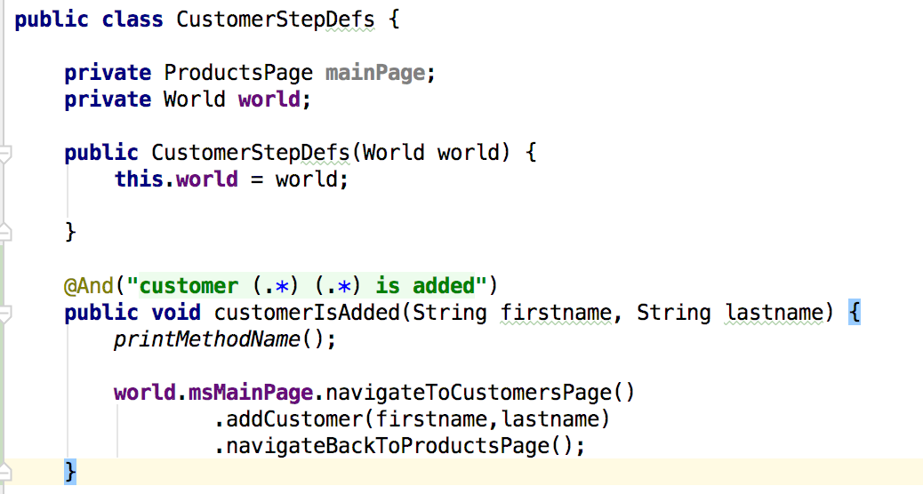
CUCUMBER JVM Sharing state between test step def files 3/3
Using preserved state from shared World object:

Slide 33
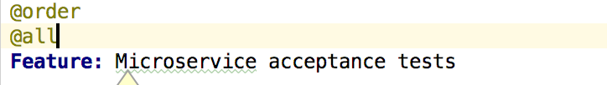
Cucumber and allure tags
With tags you can run whole feature file or just one scenario
You can run Cucumber test by tag e.g. -Dcucumber.options="--tags @order”

Slide 34
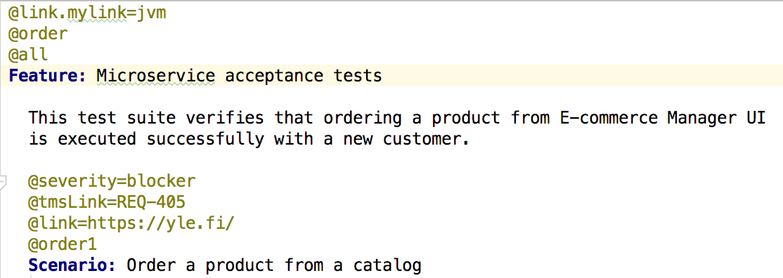
Cucumber and allure severity, issue&tms links, plain links
You can add description, severity, links to issues and test management system (tms) as well as plain links visible in report. Note: for issues and tms use allure.properties for adding link patterns.

Slide 35
Selenide lib without manual webriver binary setting
<dependency> <groupId>com.codeborne</groupId> <artifactId>selenide</artifactId> <version>4.9.1</version> </dependency> <dependency> <groupId>io.github.bonigarcia</groupId> <artifactId>webdrivermanager</artifactId> <version>2.0.1</version> </dependency>

Slide 36
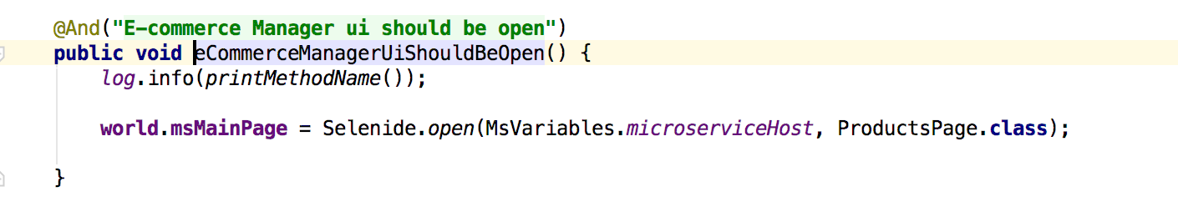
SELENIDE page objects when open browser

Slide 37
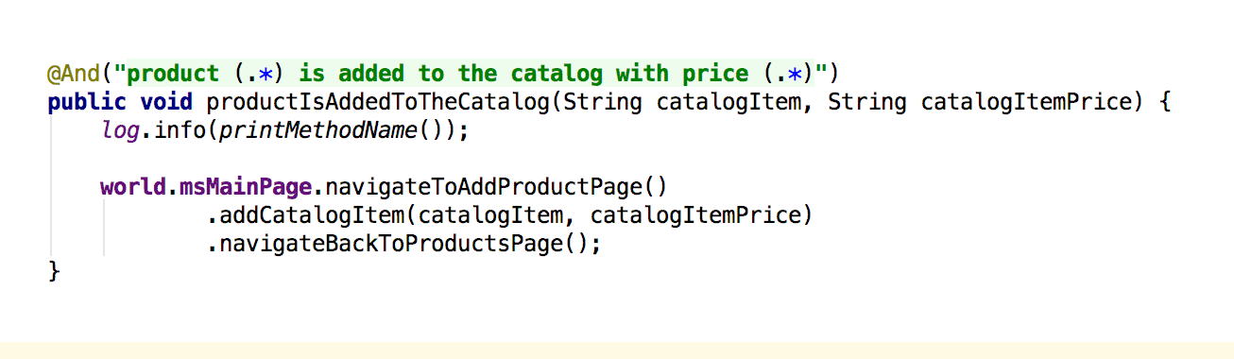
Selenide Page objects in use
Cucumber step definition with Selenide page object style of UI navigation:

Slide 38
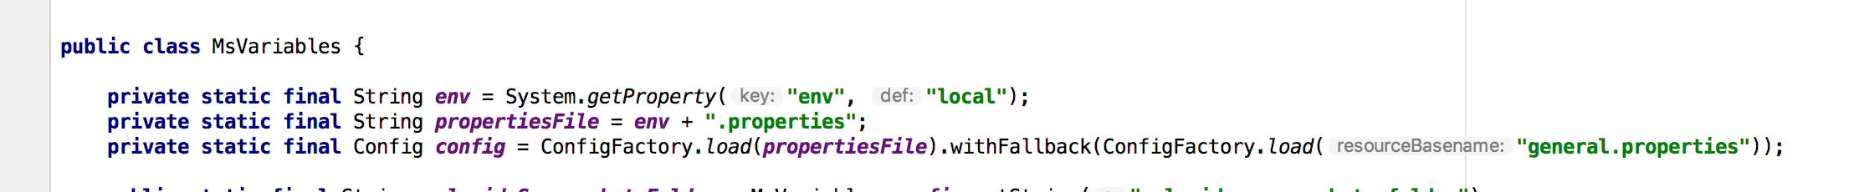
Useful libRARIES TYPESAFE library for properties
<dependency> <groupId>com.typesafe</groupId> <artifactId>config</artifactId> <version>1.2.0</version> </dependency>

Slide 39
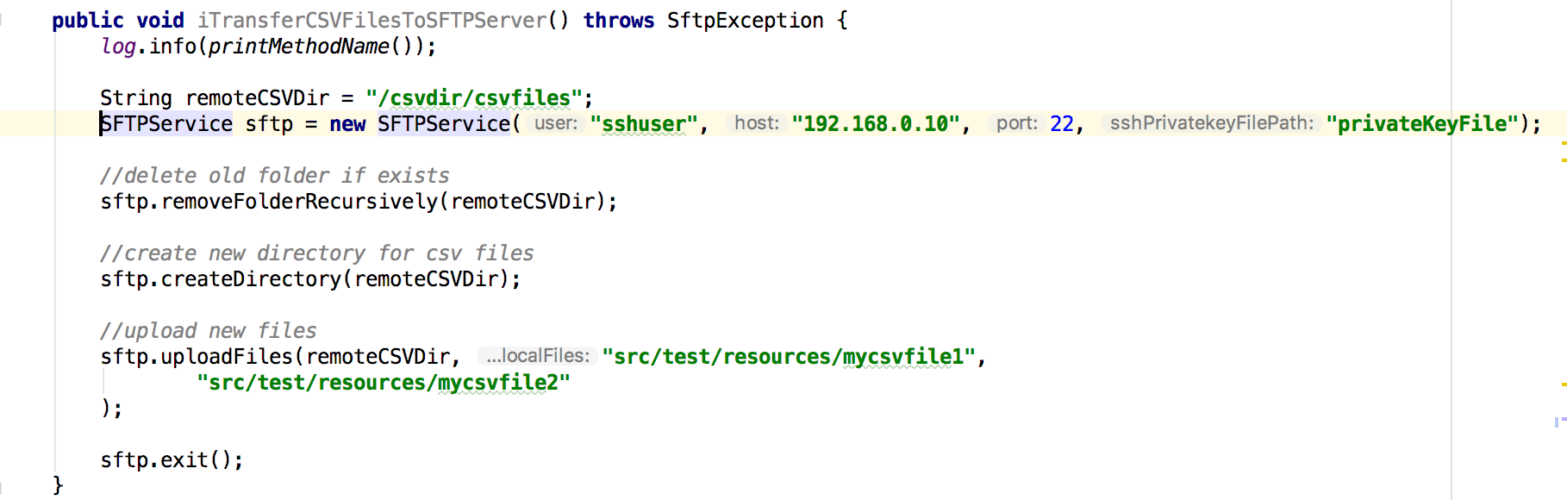
Useful libraries SCP & SFTP
See SSHService and SFTPService classes in helper package
See SSH examples in demo package

Slide 40
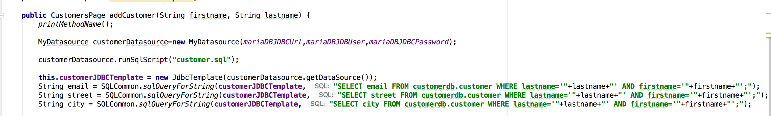
Useful libraries spring-jdbc stuff for DB connections
See dependencies from pom.xml
See .. src/test/resources/customer.sql

Slide 41
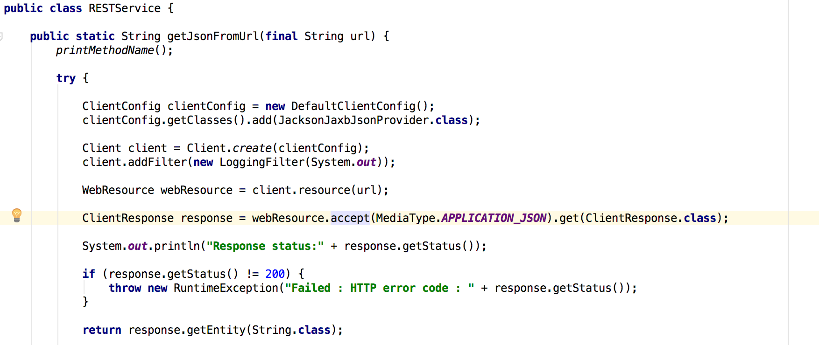
USEFUL libraries jersey and jackson for REST Services
See .. src/test/resources/acceptancetests/get-catalog-item.feature
See .. src/main/java/microservice/helper/RESTService.java

Slide 42
Continuos integration for running cucumber jvm tests
You can run run tests with Maven in any CI system, like Jenkins, GoCD etc and get the test running automatic.
In this demo GoCD is used when 3 testcases are running WEB UI tests PARALLELLY to BrowserStack.
See ../cucumber-selenide-allure/cucumber.andon.yml as just example when using GoCD (with some company specific enlargement in yaml format).
GoCD Yaml plugin spec:https://github.com/tomzo/gocd-yaml-config-plugin
NOTE: Setupping CI/GoCD system is not part of this demo!

Slide 43

The end
Now already, another hour of demo, please…

